Slide 1

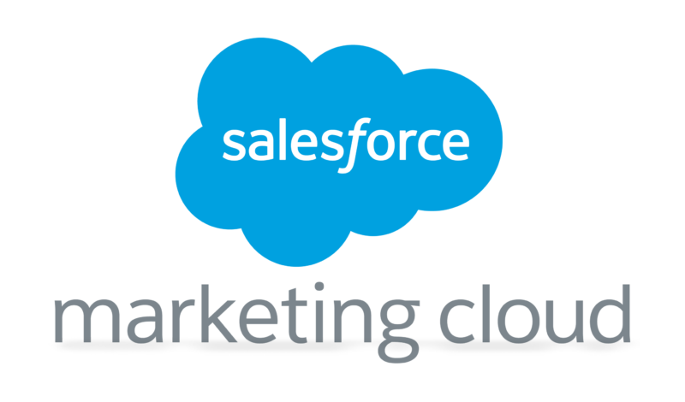
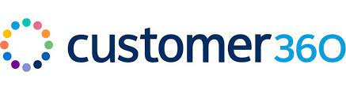
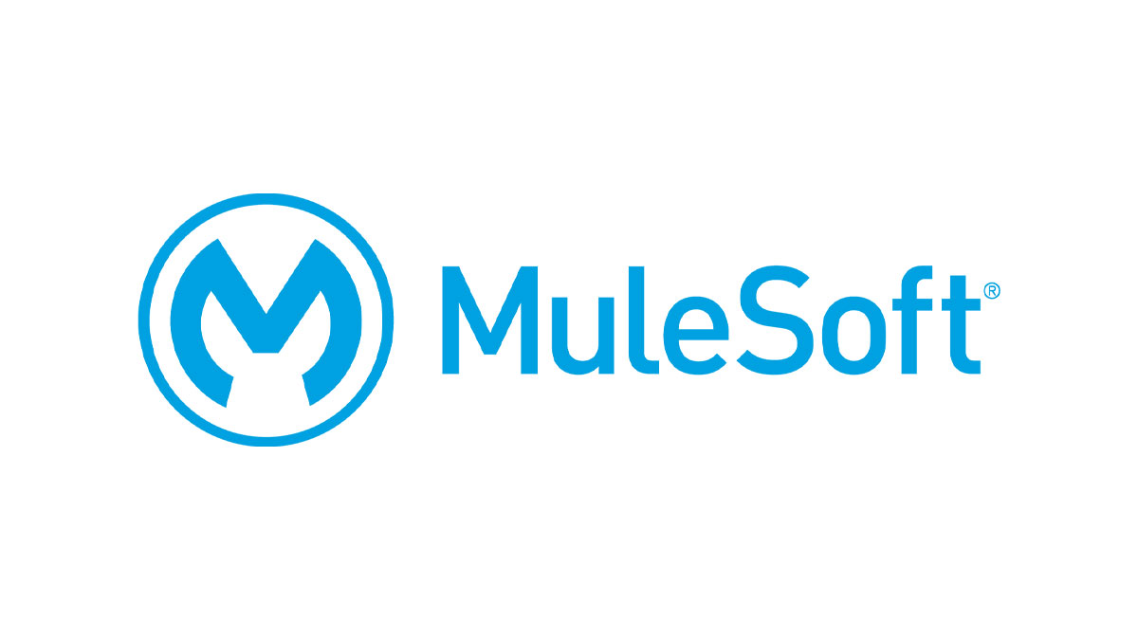


STELLANTIS DCX Account story
Account Executive: Arun Thiagarajan(APAC)/Alexis Marchand (Europe)

Slide 2
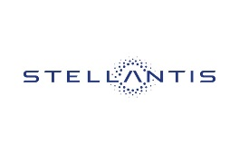
A MULTINATIONAL AUTOMOTIVE MANUFACTURING CORPORATION FORMED ON THE BASIS OF A 50–50 CROSS-BORDER MERGER BETWEEN THE ITALIAN-AMERICAN CONGLOMERATE AUTOMOBILES
Overview
Business Value Delivered
MyMarque Mobile App: Implemented MyMarque Mobile App to improve the client’s customer journey and provide a better solution to end users
CRM and Dealer Management System: We created a one-stop-shop solution for dealers – a single view covering onboarding, forecasting, inventory monitoring, dealer training, and performance measurement using Salesforce
Customer First Integration Solution: We improved the quality of the platform on Leads, Sales & other bundles using MuleSoft Solution by providing a single customer view
MyMaque App released in 65+ Countries
CRM & Dealer Management Solution provided additional revenue of $22.5B globally
Customer First Integration Solution rolled out in 10 Countries
1
3
MyMarque Mobile App has a rating of 4+ on App Store
MyMarque Mobile App (Ongoing)
Customer First Integration Solution (Ongoing)
CRM and Dealer Management Solution provides a 360-degree view of customers for dealers
2016
2018
2020
CRM and Dealer Management System (Ongoing)
Customer First Integration Solution project implemented for 14 brands
2

Slide 3

Client: Stellantis
Sector: Automotive
Country: Europe
Engagement Start Date: June 2016 End Date: May 2025
Engagement Value (Euro million): 10M
Team Size: Onshore: 24 Offshore: 20 Nearshore: 12
All Technologies: Android - Java/Kotlin, iOS - Obj-C/Swift
Account Manager: Portier, Clément
Engagement Manager / Contacts: Amroun, Yacine/ Chaubey, Manjusha
Callable (Y/N): N
If Callable, Callable contact: N/A
Reference last update: May 2023
MYMARQUE MOBILE APP
Challenge
The client wanted a mobile app for its end users through which they could operate their cars. Capgemini proposed MyMarque to the client to improve their customer journey and provide a better solution to end users. Capgemini is helping the client in providing support for their application.
Solution
Formed a team of developers and testers to develop & validate the features to be delivered to the end users using the Scaled Agile Framework
Created a governance plan to manage the timeline of the feature releases, monitor the releases, and provide L4 support to the end customers for their issues
Created a task force to tackle critical issues
Developed a mobile app to:
Access the vehicle / connected services information
Find all the driving statistics
Manage the vehicle maintenance
Control the vehicle wherever you are and when you want
App released in
Added
4+
Rating on App Store
65+
Countries
100+
Features
Business Value
1st client app
to be commercialized
More than 98% Crash Free users on the app
Capacity to deliver ~750 story points per Release
Capacity to test ~8700+ scenarios for features

Slide 4





Client: Stellantis
Sector: Automotive
Country: APAC/Europe
Engagement Start Date: 2018 End Date: Ongoing
Engagement Value (Euro million): 5.2M (APAC) /28M (Europe)
Team Size: 72(APAC)/150(Europe)
All Technologies: Salesforce, Fuse, SAP
Account Manager: Rajesh Dubey(APAC)/Cuello De Andres, Pablo pablo.cuello@capgemini.com (Europe)
Engagement Manager / Contacts: Zahida Mutalib (APAC)/Joshi, Anand anand.b.joshi@capgemini.com (Europe)
Callable (Y/N): N
If Callable, Callable contact:
Reference last update:
CRM AND DEALER MANAGEMENT SYSTEM
Challenge
The disparate app landscape of the two pre-merger brands led to a poor customer and dealer experience and increased dissatisfaction about the same. This is when the client decided to streamline the business, drive simplification, bring dealers onto a unified network, and provide maximum value to the customer.
Solution
Capgemini built a unified first-of-its-kind CRM & Dealer Management integrated solution in APAC and Europe region in Salesforce covering :
Lead, Opportunity, test drive, Quote and order management via CRM
Integration with the Sales Online (SOL) ‘Digital Platform’ enabling a step closer to an effective digital sales channel
Social affiliates and brand website connected with a single platform
DMS solution covering Vehicle, Parts, Sales and after-sales functionalities with inventory tracking and integration with SAP at the backend in APAC region
One stop-shop solution for dealers – single view covering onboarding, forecasting, inventory monitoring, dealer training and performance measurement
Campaign management to cover brand launches and journeys using SMS, emails
Other feature functionalities include online service appointment, Dealer Portal, RSA, Warranty & Claims management, Connected Cars, Social media integration, customer care, data privacy, knowledge management, schemes & incentives
Global Markets
Global Brands
Digital Strategy
15
(APAC & Europe)
14
$22.5B
additional revenue by 2030 (Global)
Business Value
360-degree view of customers for Dealers
Easier KPI measurement & tracking
Real-time reporting
Monetized Dealer model in India Asia Pacific (IAP) and Europe
Notes:
https://x-port.capgemini.com/group-priorities-gallery/use-case/crm-implementation-to-give-360-degree-customer-view/

Slide 5



Client: Stellantis
Sector: Automotive
Country: Europe
Engagement Start Date: June 2020 End Date: Ongoing
Engagement Value (Euro million): 8M
Team Size: Onshore: 10 Offshore: 30
All Technologies: Mulesoft, Heroku
Account Manager: Cuello De Andres, Pablo pablo.cuello@capgemini.com
Engagement Manager / Contacts: Joshi, Anand anand.b.joshi@capgemini.com
Callable (Y/N): N
If Callable, Callable contact:
Reference last update:
CUSTOMER FIRST INTEGRATION SOLUTION
Challenge
The client wanted a solution to tackle the backlog created due to multiple business features and identify a workaround to unblock the business. They wanted to increase the reliability and robustness of the integration layer in the legacy systems by improving the monitoring reactivity, and analysis quality and reducing the number of rejections. Their goal was to improve the quality of the platform on Leads, Sales & other bundles.
Solution
Capgemini helped the client through:
Optimal application and environment management
Reducing downtime through proactive monitoring and a preventative approach without hampering user journey
Reducing cost of ownership and making it predictable
Freeing IT Staff to work on transformational activities for improved business outcomes
Improving reporting and logging solutions for taskforce
Making active contribution to DA: Design Authority/ EDA: Extended Design Authority forums as part of innovation/re-engineering exercise
Sharing single customer view through all activities
Targeting and automating efficient campaigns
Integrating call centre support in all business processes
Optimizing lead capturing, conversion, automated sales process and reactivate frozen app
Making Integrations: Hybrid iPaaS based on MuleSoft & Heroku, Data management and Connect, Extract, Transform customer data from country-specific Custom Of The Shelf applications (COTS), core CRM, Marketing platforms & MDM
Support rollout across
Project implemented for
10
Countries
14
Brands
Business Value
Agile deliveries led to incremental improvements in interface monitoring and enhancements
Successful execution of multiple recovery plans on critical interfaces
Seamless integration with the CRM solution
Integrated COTS, Legacy, MDM, CRM across multiple countries

